Slide 1
11.5 HDLC
Configurations and Transfer Modes
Frames
Frame Format
Examples
Data Transparency

Slide 2
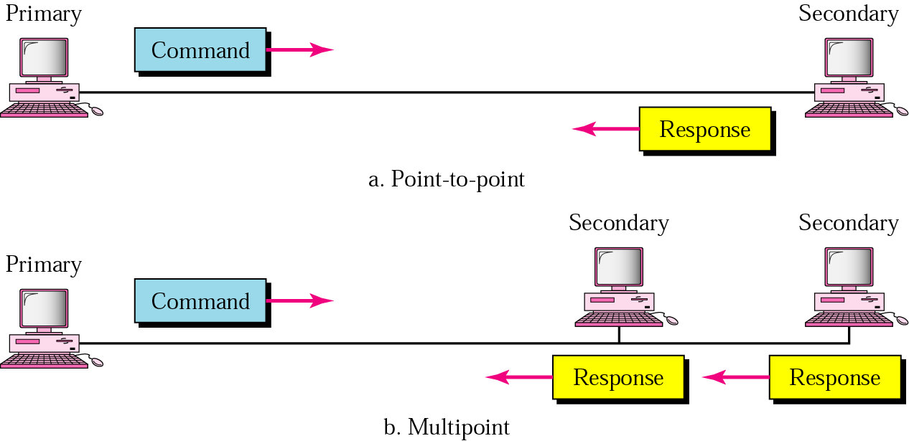
11.15 NRM

Slide 3
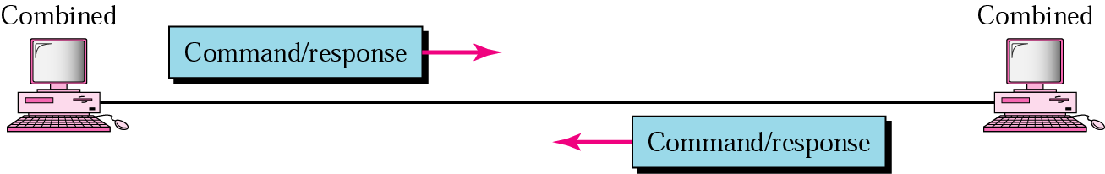
11.16 ABM

Slide 4
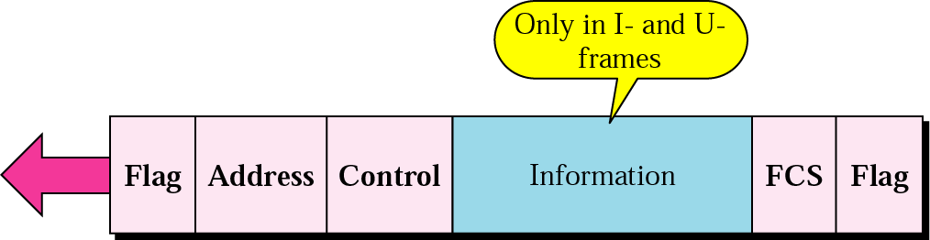
11.17 HDLC frame

Slide 5
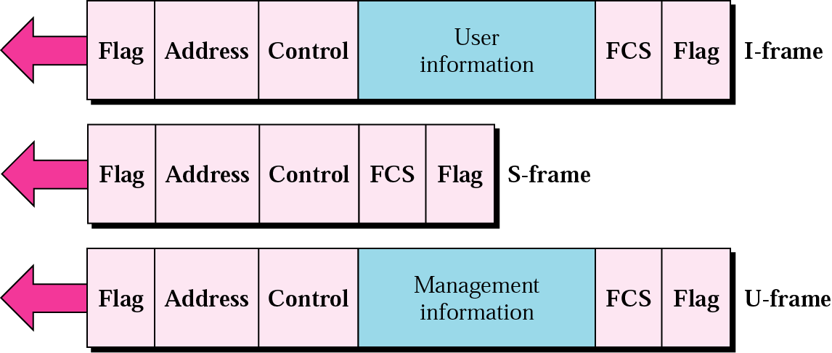
11.18 HDLC frame types

Slide 6
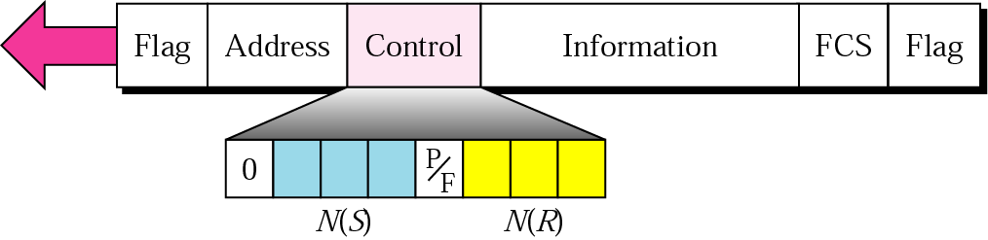
11.19 I-frame

Slide 7
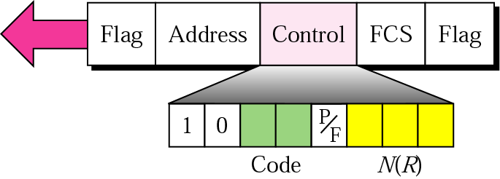
11.20 S-frame control field in HDLC

Slide 8
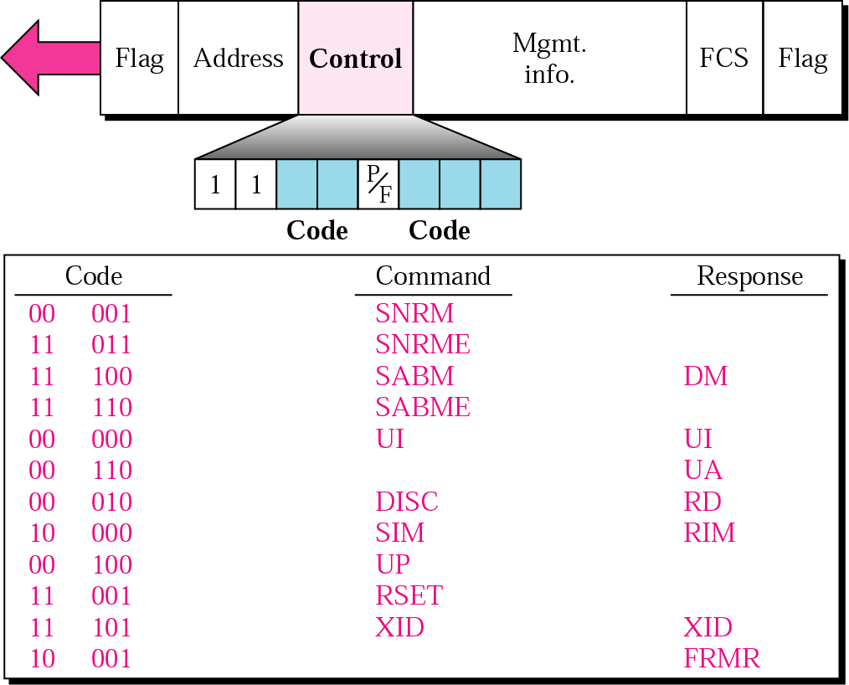
11.21 U-frame control field in HDLC

Slide 9
Table 11.1 U-frame control command and response
Command/response | Meaning
SNRM | Set normal response mode
SNRME | Set normal response mode (extended)
SABM | Set asynchronous balanced mode
SABME | Set asynchronous balanced mode (extended)
UP | Unnumbered poll
UI | Unnumbered information
UA | Unnumbered acknowledgment
RD | Request disconnect
DISC | Disconnect
DM | Disconnect mode
RIM | Request information mode
SIM | Set initialization mode
RSET | Reset
XID | Exchange ID
FRMR | Frame reject

Slide 10
Example 3
Figure 11.22 shows an exchange using piggybacking where is no error. Station A begins the exchange of information with an I-frame numbered 0 followed by another I-frame numbered 1. Station B piggybacks its acknowledgment of both frames onto an I-frame of its own. Station B’s first I-frame is also numbered 0 [N(S) field] and contains a 2 in its N(R) field, acknowledging the receipt of A’s frames 1 and 0 and indicating that it expects frame 2 to arrive next. Station B transmits its second and third I-frames (numbered 1 and 2) before accepting further frames from station A. Its N(R) information, therefore, has not changed: B frames 1 and 2 indicate that station B is still expecting A frame 2 to arrive next.

Slide 11
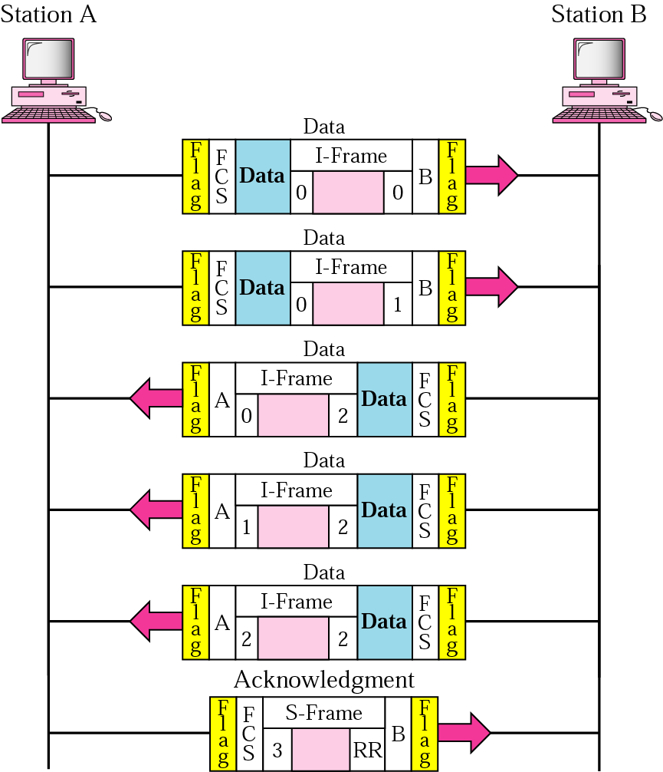
11.22 Example 3

Slide 12
Example 4
In Example 3, suppose frame 1 sent from station B to station A has an error. Station A informs station B to resend frames 1 and 2 (the system is using the Go-Back-N mechanism). Station A sends a reject supervisory frame to announce the error in frame 1. Figure 11.23 shows the exchange.

Slide 13
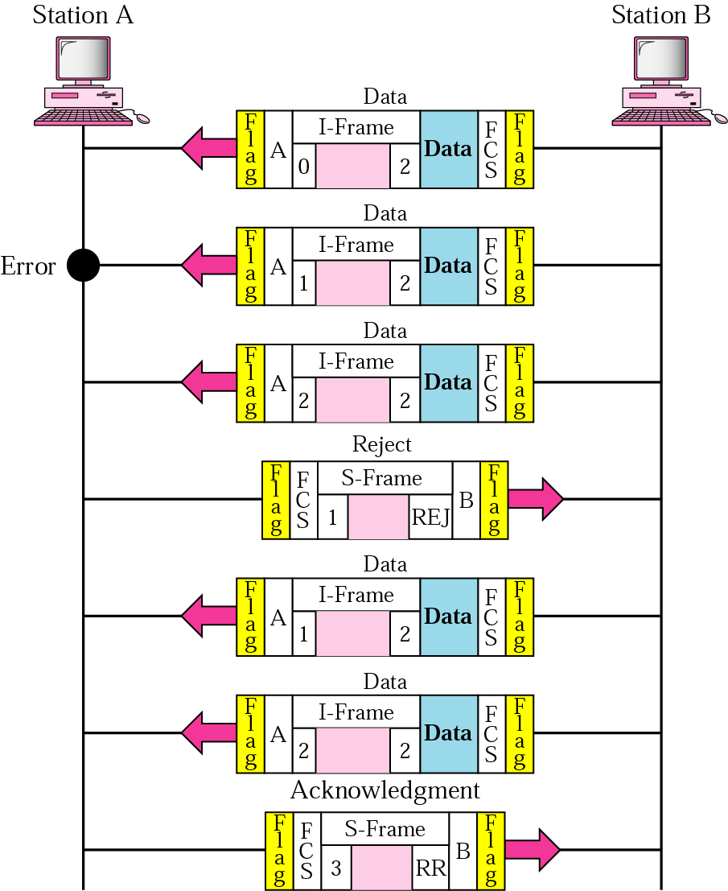
11.23 Example 4

Slide 14

Note:
Bit stuffing is the process of adding one extra 0 whenever there are five consecutive 1s in the data so that the receiver does not mistake the
data for a flag.

Slide 15
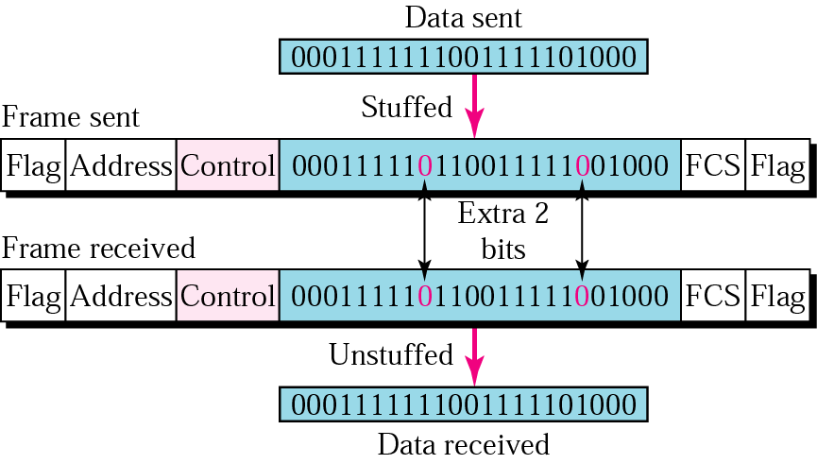
11.24 Bit stuffing and removal

Slide 16
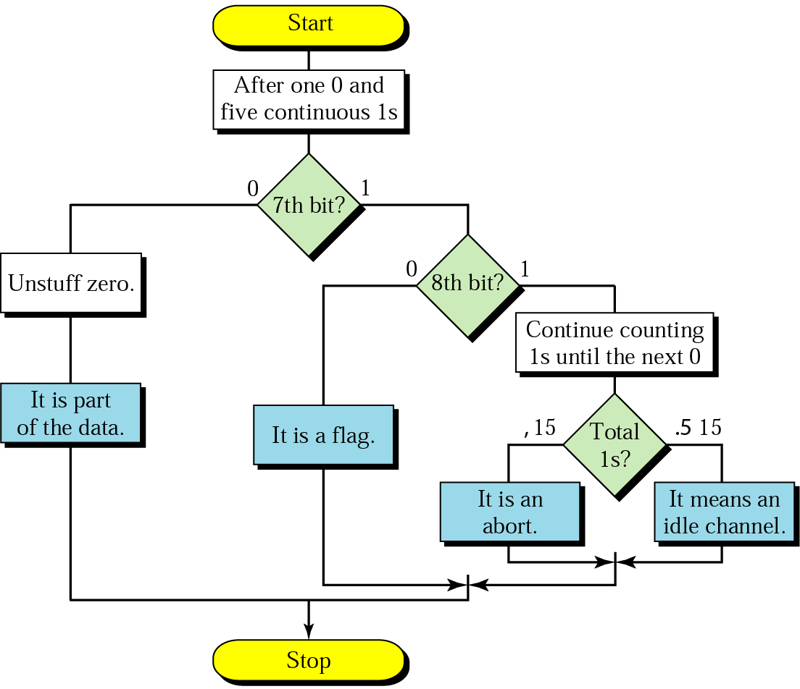
11.25 Bit stuffing in HDLC

